Slide 1


TERMINATORS
Explore the joy of flavours just in few clicks

Slide 2

RUCHIKA JAIN
FIRST YEAR
PRAJWAL SONI
FIRST YEAR
PRADEEP SINGH
FIRST YEAR
SANYAM JAIN
FIRST YEAR
HARDIK SHARMA
FIRST YEAR

Slide 3

A bot to reduce man work and make things contactless inside a restaurant. This can be easily accessed by scanning a QR Code.
TERMINATORS

Slide 4


Problem 1
Keeping the menus clean with no grease and no food.
Problem 2
COVID-19 AFFECTED THE RESTAURANT BUSINESS BADLY.
Problem 3
Contactless AND HYGENIC FOOD ORDERING.
Problem 4
TEDIOUS TASK TO CUSTOMIZE THE MENU.
TERMINATORS

Slide 5

Solution 1
CHATBOTS - A TECHNOLOGY TO MAKE OUR WORK EASY.
Solution 2
QR CODE TO SCAN A SOLUTION FOR OUR PROBLEMS.
Solution 3
CUSTOMIZE THE MENU WITH JUST SOME CLICKS.
TERMINATORS

Slide 6
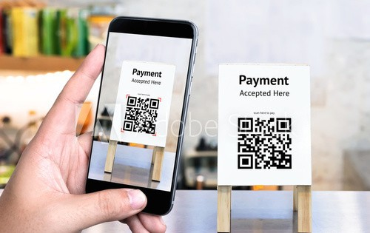
SCAN ME
SCAN ME
TERMINATORS

Slide 7
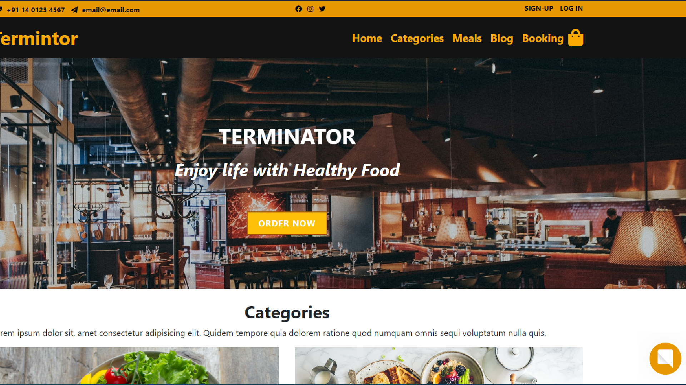

Slide 8
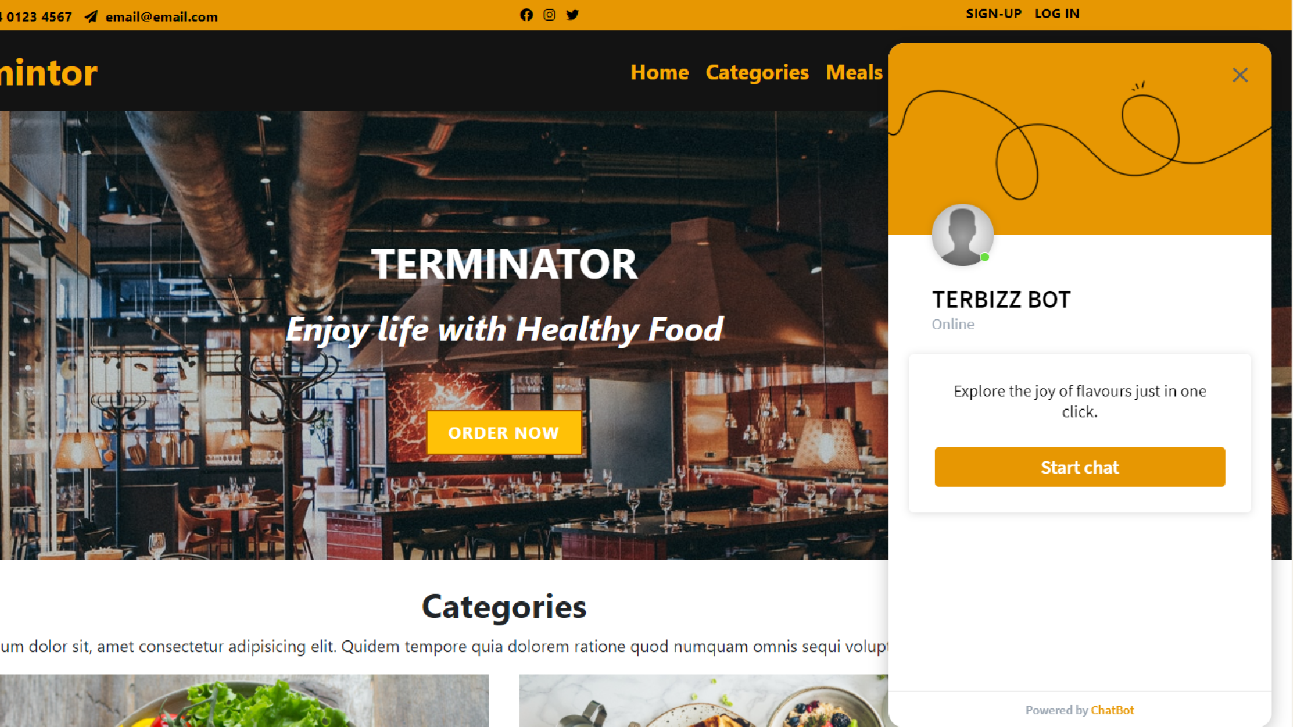

Slide 9
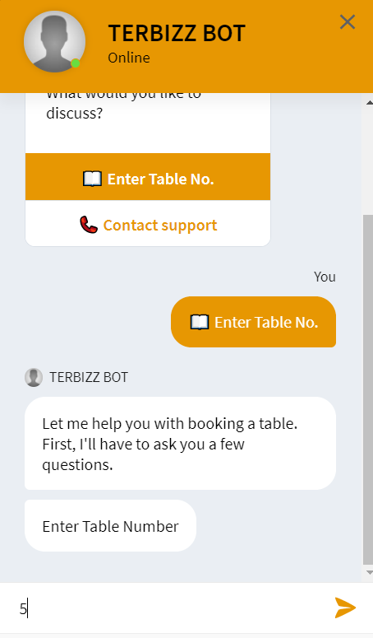
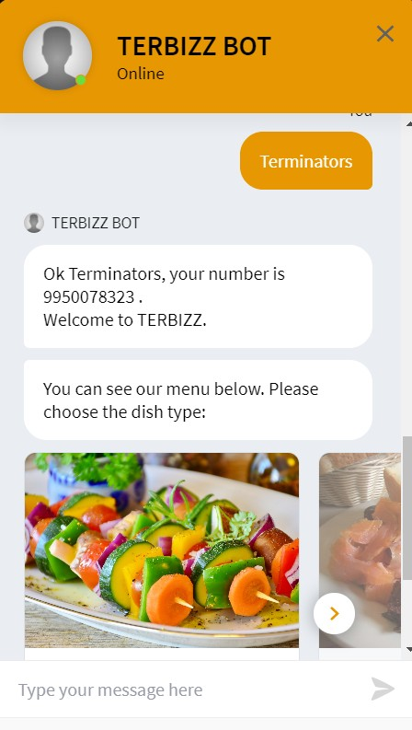
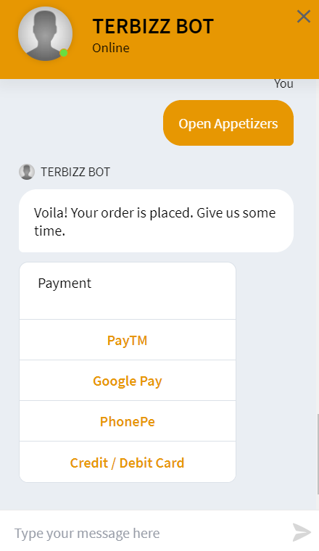

Slide 10



PROVIDE INSTANT RESPONSES
DATA GATHERING
HELP IN UPSELLING
GUIDE USERS FOR BETTER EXPERIENCE
CUSTOMIZABLE MENU

Slide 11
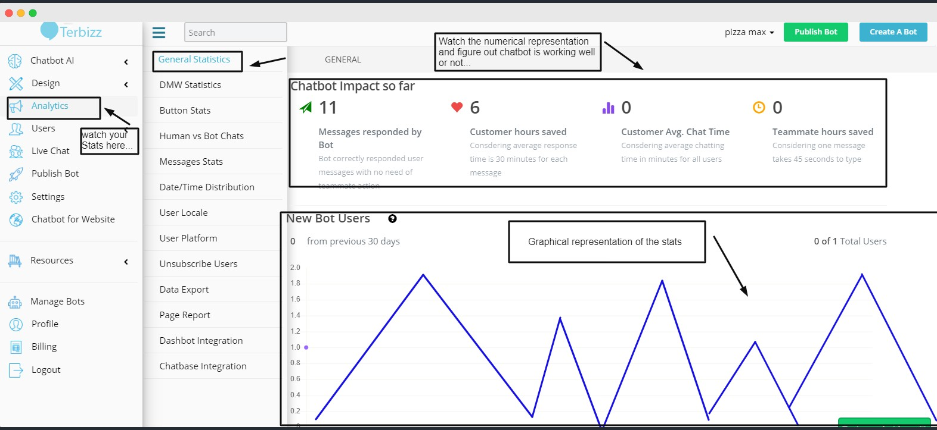

Slide 12
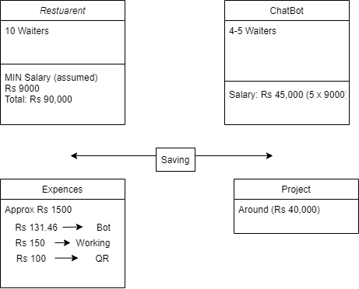



Slide 13

HTML5 AND CSS3
WEB DEVLOPMENT
BOOTSTRAP
JAVASCRIPT

Slide 14
AN EFFICIENT COMMUNICATION TOOL.
QUICK AND EFFECTIVE SOLUTION TO THE PROBLEM.
CONCLUSION

Slide 15


